Slide 1
Breast cancer detection using machine learning algorithms
D SUNDER RAJ, 112015042

Slide 2
introduction
Breast cancer (BC) is the most common cancer in women, affecting about 10% of all women at some stages of their life. Over the past few decades, ML techniques have been widely used in intelligent healthcare systems, especially for breast cancer (BC) detection and diagnosis. It has been identified that one of the leading causes of death in developing countries as breast cancer. Earlier detection of cancer can reduce the death rate and reduce the treatment phase. To make the process much simpler computer aided tools are adopted. The objective of this work is to classify the given data set into different types of breast cancer i.e. Benign or Malignant.
A mass of abnormal tissue is known as tumor. Breast cancer tumors are classified into two types,1. Benign, those that are non-cancerous, and Malignant, those that are cancerous.
Benign Tumors
: Generally, these tumors are not aggressive toward surrounding tissue, they may continue to grow occasionally.
Malignant Tumors
: Malignant tumors are cancerous and aggressive because they invade and damage surrounding tissue. `K-Nearest Neighbors (K-NN) is one of the most prominent classification algorithms because it is simple, effective and more accurate than many other classification algorithms. This algorithm does not require any assumption for detection

Slide 3
Objective
The main objective behind this project is to help women by helping them diagnose Breast Cancer (BC) using their cell reports and detect about the type of breast cancer, if it non-dangerous and can be treated or dangerous so as to help them know what measures they can take at an early stage
To help women diagnose cancer type we are making an application which will help women to identify the cancer type using machine learning techniques so as they can get to check in at early stages of disease just by putting the credentials asked on application with the help of their reports and identify type, which can decrease the death rate due to breast cancer

Slide 4
Misconception
Men do not get breast cancer it affects women only is a myth
The American Cancer Society estimates for breast cancer in men in the United States for 2022 are: About 2,710 new cases of invasive breast cancer will be diagnosed. About 530 men will die from breast cancer

Slide 5
Problem statement
Predicting person’s Tumour (malignant or benign) based up on his or her tumour features and cell report
the machine learning algorithm can help to diagnose it.
I have used K-NN algorithm could be used for this problem statement

Slide 6
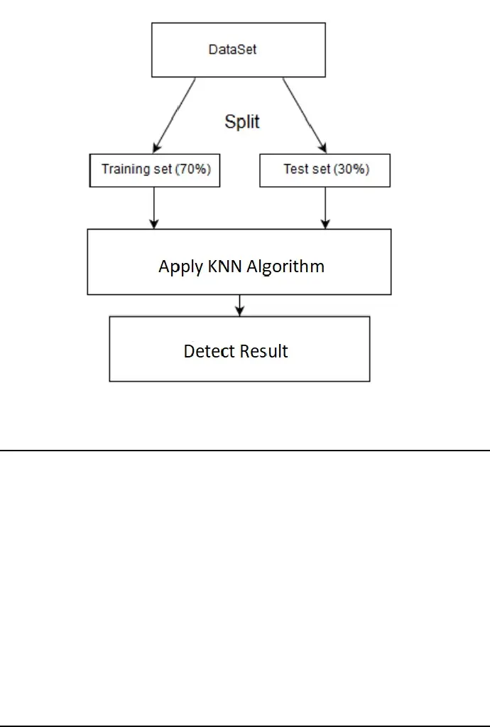
Methodology
The proposed methodology is shown in Figure. The main idea is to use k-NN algorithm to predict the class labels in the test set. Then for each classifier, the con formal prediction algorithm is applied to calculate the non-con formality score for each prediction and use it to calculate the confidence. The con-formal prediction algorithm is fully described.
We can predict the
Bc type based on the
Information available in
The data set using
KNN algorithm

Slide 7
Proposed solution
Wisconsin breast cancer dataset (WBCD) from UCI respiratory is taken and this dataset has 699 clinical cases, each one labeled as malignant (cancerous) or benign (non-cancerous). The number of malignant and benign cases are 241(24.5%) and 458(65.5%), respectively.
The user will input the parameters of the cell mentioned in the report prepared using the information from the imported data set. These parameters will decide the type of cancer using KNN Algorithm prediction
At first, the values given by the user specificity, the accuracy for different values of K between 1 and 614(from the data set) is reported to show the individual performance of the classifier on positive and negative classes. After that, the maximum values, minimum values, and standard deviations of positive and negative classes are examined to show the stability of classifier over positive and negative classes. Then the system detects the cancer type depending upon the training dataset and user dataset

Slide 8
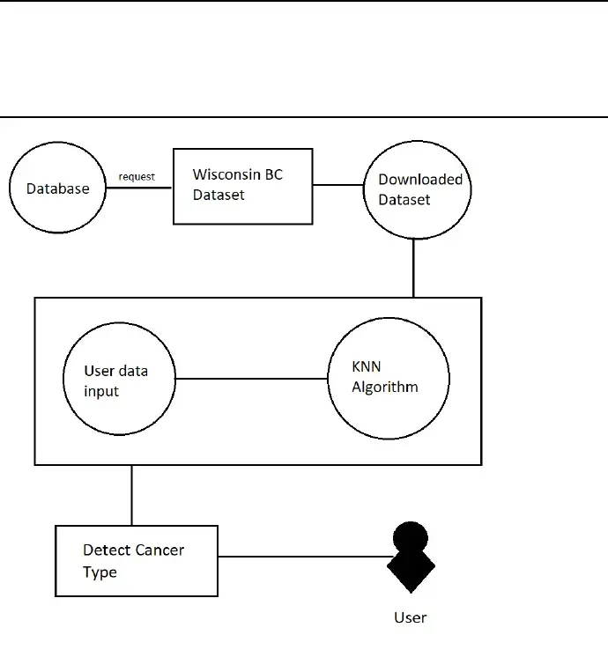
Data flow diagram

Slide 9
conclusion
We have proposed Breast Cancer Detection System Based on KNN Algorithm which is a machine learning technology. This approach increases the chances of detecting breast cancer in early stages so as women can start treatment to be cured or decrease the chances of death in this cases. This will in turn increase the mortality rate and help women to spread awareness regarding breast cancer diagnosis

Slide 10
references
1. The Performance of K-Nearest Neighbors on Malignant and Benign Classes, Arash Roshanpoor, Reza Safdari [2017]
2. Cancer Prediction Using KNN,Dheeraj. R ,Hariprasath.R, Akshay Kannan.V , NishanthKumar.S [2018]
3. Breast Cancer Detection Using K-Nearest Neighbor Machine Learning Algorithm, Moh'dRasoul Al-Hadidi, Abdulsalam Alarabeyyat, Mohannad Alhanahnah [2016]
4. Breast Cancer Diagnosis by using k-Nearest Neighbor with Different Distances andClassification Rules s Ahmed Medjahed, Tamazouzt Ait Saadi, Abdelkader Benyettou
5. H. Zhang, T. Arslan, B. Flynn, A Single Antenna Based microwave System for BreastCancer Detection: Experimental Results, IEEE, 2013.
6.Medjahed SA, Saadi TA, Benyettou A. Breast Cancer Diagnosis by using k-Nearest Neighbor with Different Distances and Classification Rules. Int J Comput Appl. 2013;62
7. Gupta S, Kumar D, Sharma A. Data Mining Classification Techniques Applied For Breast Cancer Diagnosis And Prognosis

Slide 11
THANK YOU
everone

